Slide 1
Road Sign Recognition
-presented by
Bobba Shruti
Nehanvitha Adapa
Kumar Akash Chowdary Kommina
Venkata Mahesh Kanugula

Slide 2
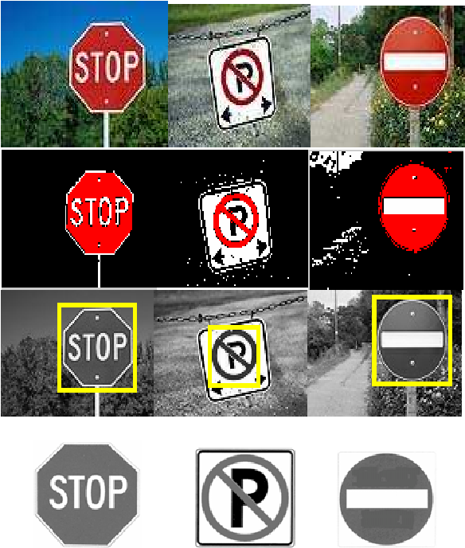
Introduction
Road sign recognition is an essential component of intelligent transportation systems, which aim to improve road safety, reduce congestion, and enhance the driving experience. With the rapid development of machine learning techniques, road sign recognition has become an increasingly popular research topic in recent years.

Slide 3
Problem statment
This project's objective is to create a traffic sign identification system utilizing machine learning techniques and the german traffic sign recognition benchmark dataset. The system must be effective and able to operate in real-time, and it must be able to recognize and classify various kinds of traffic signs with accuracy. Various lighting circumstances, some signs' resemblance, and the demand for real-time performance are the key obstacles.

Slide 4
Proposed solution
Our method entails creating a precise and effective road sign identification system using a deep learning-based strategy and a convolutional neural network (CNN). The strategy encompasses model building, model evaluation, and deployment in addition to data preprocessing. To increase traffic flow and road safety, the final system can be placed in individual vehicles or linked into already-existing intelligent transportation systems.

Slide 5
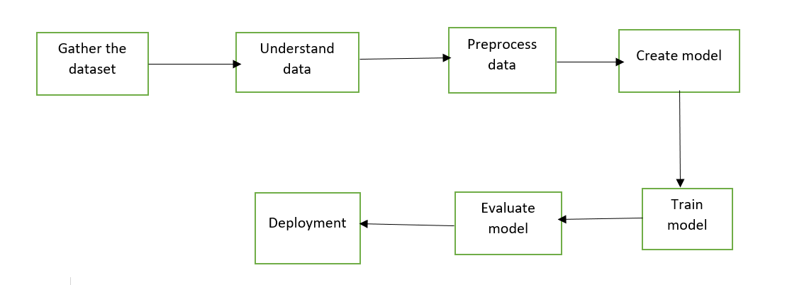
Methodology

Slide 6
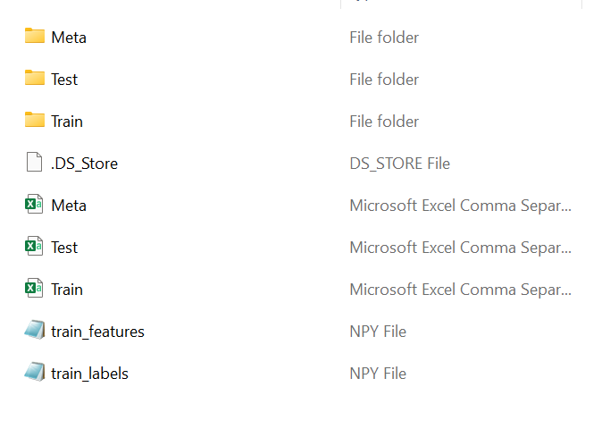
Gathering data
Here we are using GTSRB - German Traffic Sign Recognition Benchmark dataset.

Slide 7
Understanding and Preprocessing data
Before building a road sign recognition system, it's important to understand and preprocess the data to ensure that it's of high quality and consistency. The german traffic sign recognition benchmark dataset contains over 50,000 images of road signs, and it's essential to preprocess the data to improve the performance of the machine learning algorithms.
Image resizing
Image normalization
Image augmentation
Data visualization

Slide 8
Create, train and evaluate model
The efficacy and accuracy of the machine learning model utilized determine how well a traffic sign recognition system performs. In this project, we suggest classifying several kinds of traffic signs using a convolutional neural network (CNN).
Architecture design
Data preparation
Training the model
Model evaluation
Hyperparameter-tuning

Slide 9
Deployment
Integrating a traffic sign recognition model into a web page is one method to use it. Users can upload a picture of a road sign and get an estimate of the type of sign it is.
Create a web application
Model integration
Image preprocessing
Model inference
Display the results

Slide 10


